Slide 1
Java Spring Boot express course

Slide 2
Spring Boot
Multi-tier structure
Spring Beans

Slide 3
Prerequisite

Slide 4
Programs needed
IntelliJ IDEA Community Edition
Java version 21
Maven 3.x.x
Postman

Slide 5
Spring and Spring Boot

Slide 6


Spring and Spring Boot
Spring is an open-source web application framework base on Java. It provides flexible and configurable environment using prebuilt tools and libraries to create customized web apps.
However, with Spring, you will have to setup the web server and other configurations explicitly for for the application to work as a web application. To simplify the development procedure, Spring Boot which is a Spring module that comes with preconfigured configurations and built in HTTP servers like Tomcat.
For that reason, building Java-based web application with Spring Boot gives developers a faster start.

Slide 7
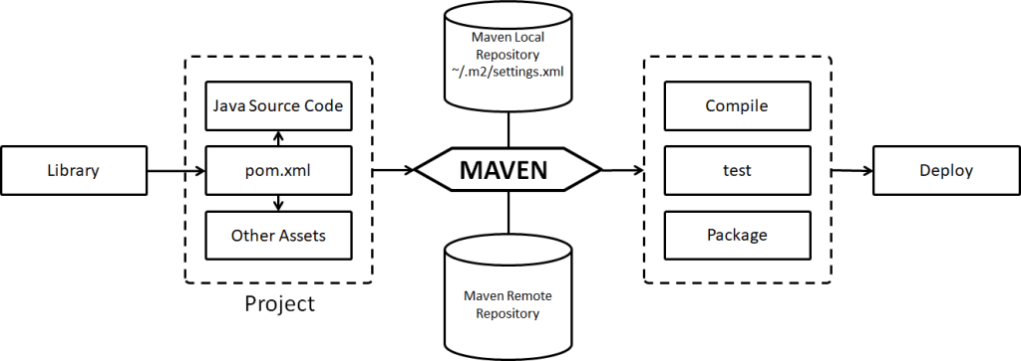

Building and packaging a Spring Boot application with Maven
Building and packaging a Spring Boot application can be cumbersome. Especially when we have dependencies and external libraries.
Maven, a build tool created by Apache helps us simplify building, managing a packing a Spring Boot application. Producing Java archive formatted files with everything from source code to dependencies managed and packaged

Slide 8

Initiate a Spring Boot application
Spring Boot provides an online tool where you can use and generate a Spring Boot application
https://start.spring.io/

Slide 9
Multi-tier structure
Basic definition of the structure and why it is needed

Slide 10
Basic definition of Multi-tier structure
Multi-tier structure is the general term for breaking down an application into logical layers (tiers) where each layer has a specific responsibility.
Presentation Layer
Endpoints
UI components
Business Layer
Business logic
Data Access Layer
Data access components
Database Layer
Record processing
Utilities
SQL queries
Database
Procedures
Error Handling

Slide 11
Presentation layer
This is the topmost level of the application
Request from clients are obtained and distributed to the lower layer for processing and present processed responses.
This layer perform validation and transformation of requests.
Objects within this layer are typically called Controllers and should not depend on each other.

Slide 12
Service layer
Located right down the presentation layer. This layer contains services that do specific set of actions
Services containing logic that are related to each other should be placed under the same package
One service should only take care of its own responsibility and use method from other services for external logic that are not directly related to them.

Slide 13
Data Access Layer
This is the layer where data access components are located.
In here, we can find components that read, write data.

Slide 14
Model
This is the place used to hold classes that represent entities in the application
For example: Person, Tax
Additionally, there will be class that acts as model to transfer data between layers.
Notes:
Ngoài ra, hệ thống multi tier cũng có một package thường sử dụng cho việc chứa những class biểu trưng cho các thực thể trong hệ thống ví dụ như Person hoặc Tax.
Bên cạnh đó, cũng có những class đóng vai trò là những model để nhận và chuyển data giữa các lớp. Sâu hơn về phần này sẽ được giải thích khi ta tìm hiểu phần làm việc với dữ liệu và database

Slide 15
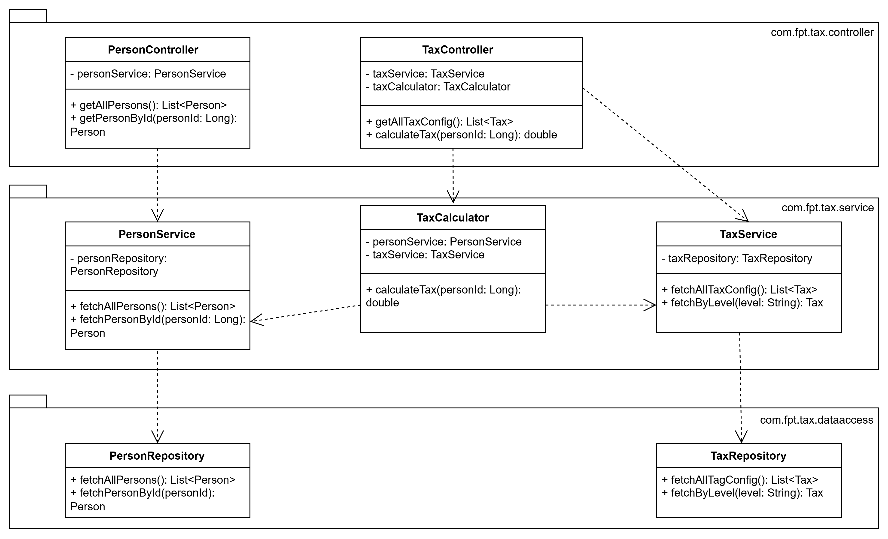
Sample structure of a Multi-tier structure project

Slide 16
Our project
We will build a sample tax calculator service
Consists of 3 layers: presentation, service, data access, model and a layer called utils to carry helper methods
To start, we will implement the flow where we get list of persons from a JSON file and display it.
Our project will be implemented in multi-tier structure
Notes:
Include
<dependency> <groupId>org.springframework.boot</groupId> <artifactId>spring-boot-starter-web</artifactId> </dependency>
For @RestController annotation
Include
<dependency> <groupId>com.fasterxml.jackson.core</groupId> <artifactId>jackson-databind</artifactId> <version>2.15.3</version> <!-- You can use the latest version --> </dependency>
For JSON
1. Create test endpoint return hello world
2. Create User object
3. Create User Repository

Slide 17
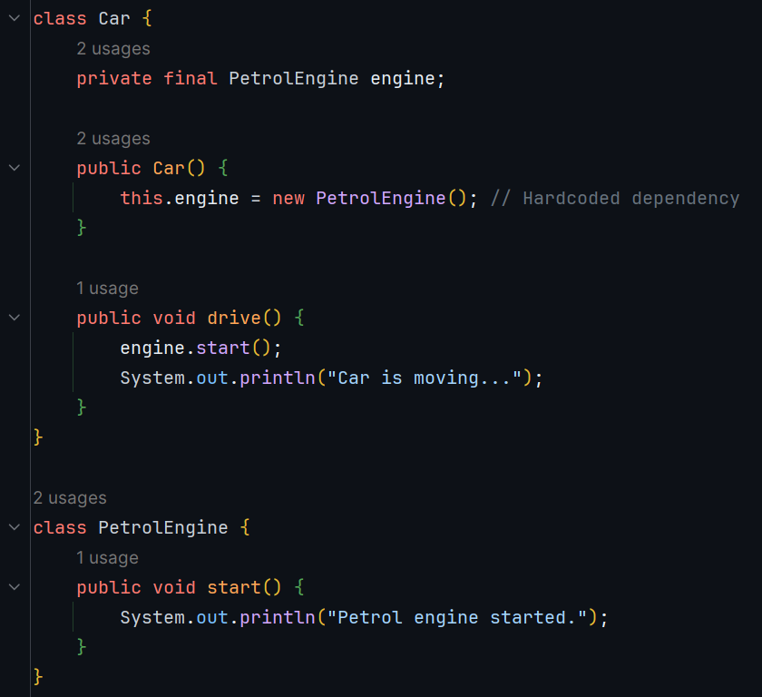
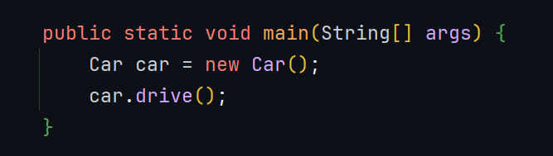
Problem !!
Car is tightly couple to one instance of PetrolEngine. What if we want to use ElectricEngine ? Modify PetrolEngine
-> Hard to reuse, hard to test !

Slide 18
Spring Beans
Basic definition and how does this benefit application development

Slide 19
Beans definition
In Spring, a Bean is an object that is managed by the dependency container. Beans are created, configured, and injected automatically by Spring, reducing the need for manual object instantiation and dependency management.
3 types :
XML–based configuration : define in xml files
Annotation-based configuration : @Controller, @Service, @Components,.. Or @Autowired, @Inject,…
Java-based configuration : From Spring 3.0, features provided by Spring java config object : @Configuration classes, @Bean methods

Slide 20
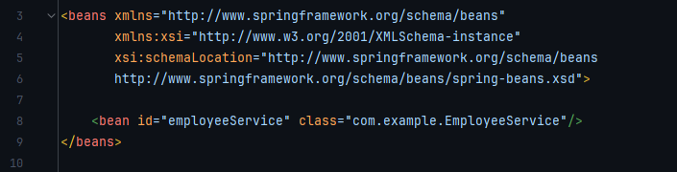
Beans definition
XML configuration

Slide 21
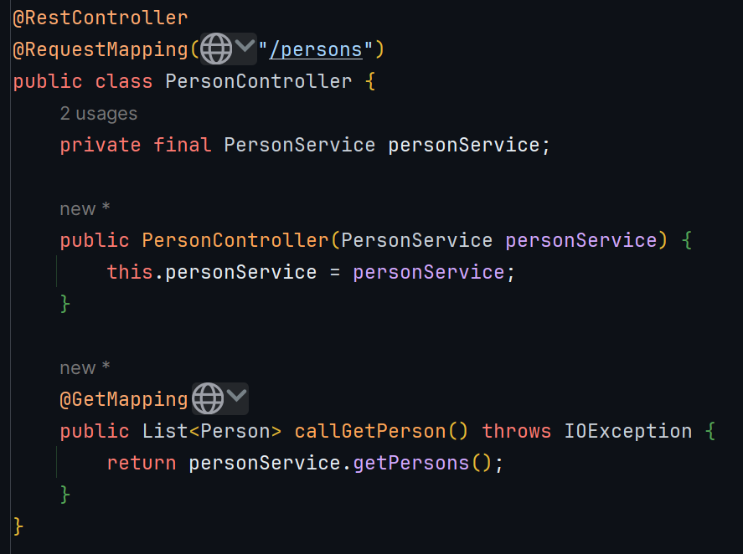
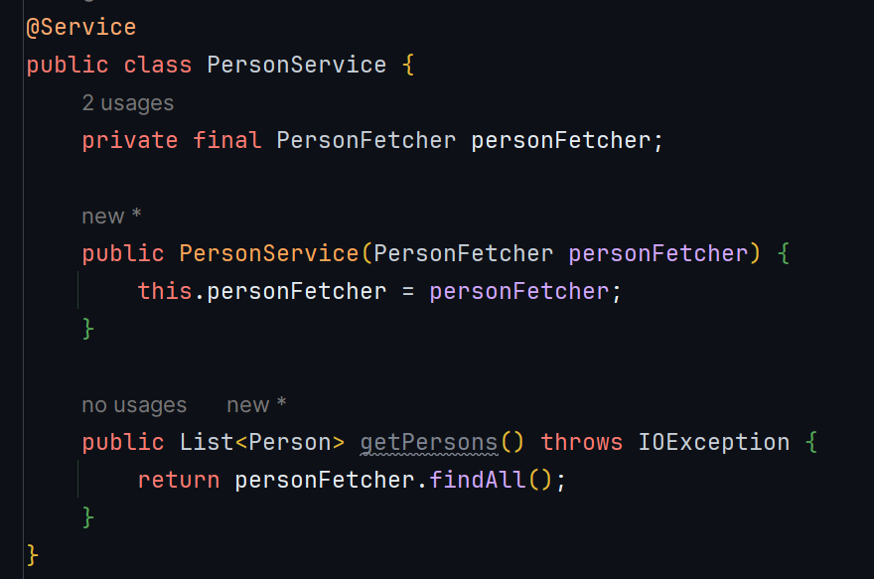
Beans definition
Annotate a class with @Service annotation. This registers the class as Spring Bean and will be managed by Spring dependency manager. Remember to do this on both dependency and dependent classes.
Add dependencies for dependent class via its constructor.l

Slide 22
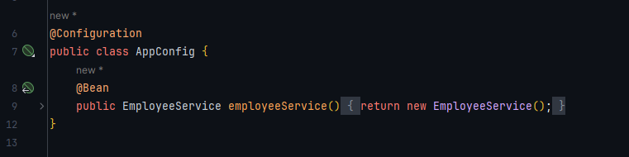
Beans definition
Java-Based

Slide 23
Beans name
Stereotype annotations : Spring uses the class name and converts the first letter to lowercase
@Bean methods : Spring use the name of the methods
Customize bean name : helpful when there’re conflicts : duplicate names or multiple implementations of the same type when auto wiring
@Component(“myComponent”), @Controller(“myController”), @Bean(“myBean”)

Slide 24
Requesting bean from dependency manager
Get Bean by type :
LoginService loginService = context.getBean(LoginService.class);
Get Bean by name :
LoginService loginService = (LoginService) context.getBean("appleService");
Get Bean by name and type :
LoginService loginService = context.getBean("googleService", LoginService.class);

Slide 25
Dependency Injection

Slide 26
Dependency injection
The idea of DI is to have an injector to create objects required by an application and inject them into their dependent objects instead of hardcoding them
Support the Dependency of Inversion of the S.O.L.I.D
dependency
Class B
Class B
Class A
IoC
Class A
Class C
Class C
dependency

Slide 27
DI advantages :
Reduced Coupling
Increase testability
Improved Code maintainability
Flexibility and reusability
Simplified Configuration
Better Resource management
Boilerplate code reduction
Concurrent development

Slide 28
Dependency injection
Add dependencies for dependent class via its constructor.

Slide 29
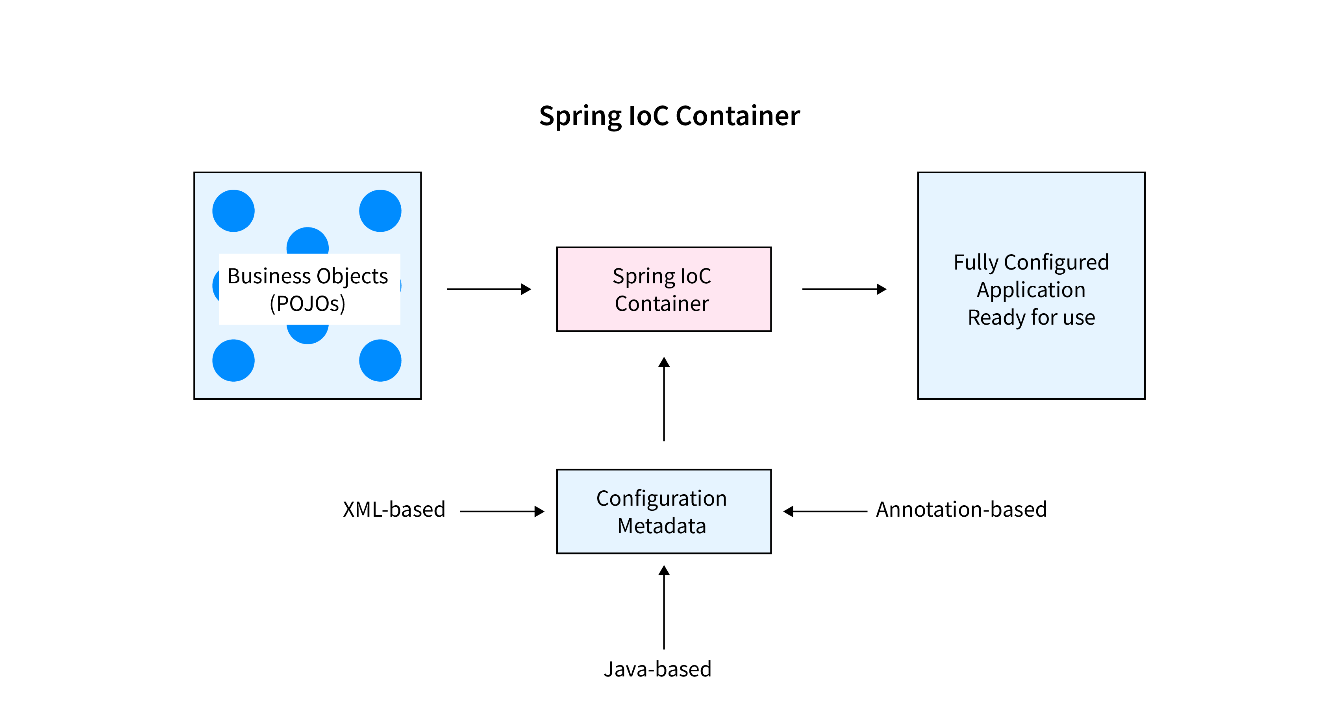
Spring IoC container
In spring boot, Spring IoC Container acts as injector for all the defined @Bean
Notes:
IoC Container là thành phần thực hiện IoC.
Trong Spring, Spring Container (IoC Container) sẽ tạo các đối tượng, lắp rắp chúng lại với nhau, cấu hình các đối tượng và quản lý vòng đời của chúng từ lúc tạo ra cho đến lúc bị hủy.
Spring container sử dụng DI để quản lý các thành phần, đối tượng để tạo nên 1 ứng dụng. Các thành phần, đối tượng này gọi là Spring Bean (mình sẽ nói về Spring Bean trong các bài sau)
Để tạo đối tượng, cấu hình, lắp rắp chúng, Spring Container sẽ đọc thông tin từ các file xml và thực thi chúng.

Slide 30
Spring IoC container
In Spring, we have 2 types of IoC container : BeanFactory and ApplicationContext
BeanFactory
XmlBeanFactory
ApplicationContext
ClassPathXmlApplicationContext
FileSystemXmlApplicationContext
AnnotationConfigWebApplicationContext

Slide 31
Keytake away !
In Sprin, the IoC (Inversion of Control) Container is responsible for managing Beans, which are Java objects created, configured, and managed by Spring.
Dependency Injection (DI) allows Spring to automatically inject dependencies into these beans, reducing manual object creation and improving modularity.
When setting up a Spring Boot project:
Mark classes as Beans – Use annotations like @RestController, @Component, @Service, or define them with @Bean in a @Configuration class
Enable DI – Use @Autowired or constructor injection to let Spring manage dependencies.
IoC Container (ApplicationContext) – Spring Boot automatically scans and registers beans, handling object lifecycle and dependencies.

Slide 32
Further research
Spring beans :
Lifecycle and callbacks @PostConstruct, @PreDestroy
Beans scope : Singleton, Session,…
SOLID principles in OOP
Further features of Maven
Use case of Jar and War file
Difference between Maven and Gradle as well as their use case
References :
https://spring.io/projects/spring-boot
https://spring.io/
https://www.baeldung.com/
https://viblo.asia/search?q=spring%20boot

Slide 33
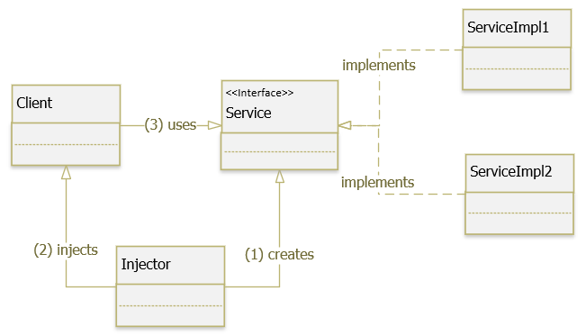
Full concept of Dependency Injection (DI)
The idea of DI is to have an injector to create objects required by an application and inject them into their dependent objects instead of hardcoding them
4 roles in DI :
Service : a class carries out the functionality
Client : a class that requests something from a service
Interface : a component implemented by a service for user by one or more clients
Injector : a component that introduces a service to a client

Slide 34
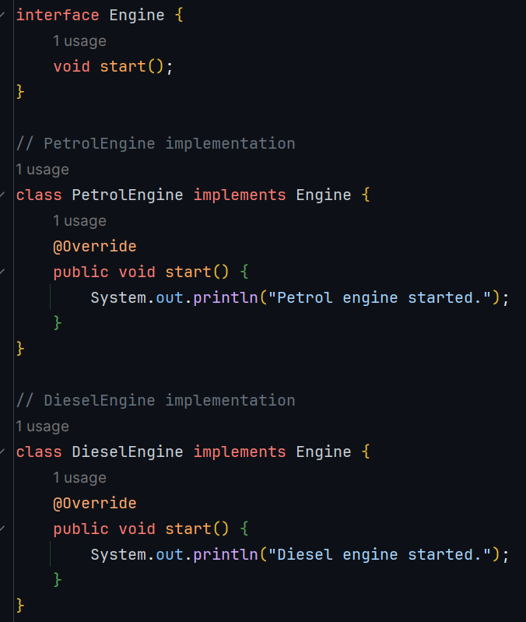
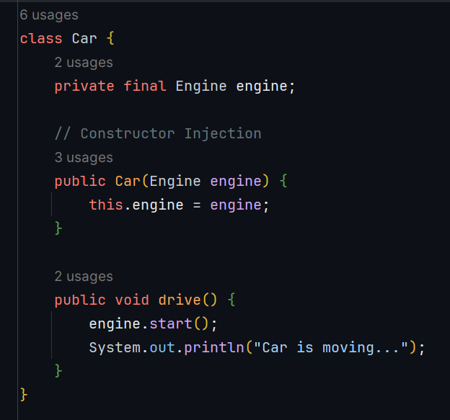
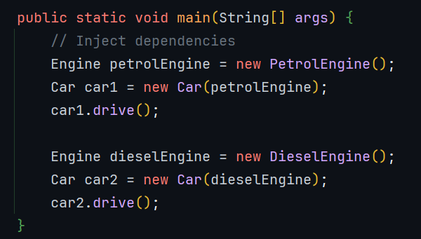
oncept of Dependency Injection(DI)
Inject dependencies to the object
interface
client
service
injector

Slide 35

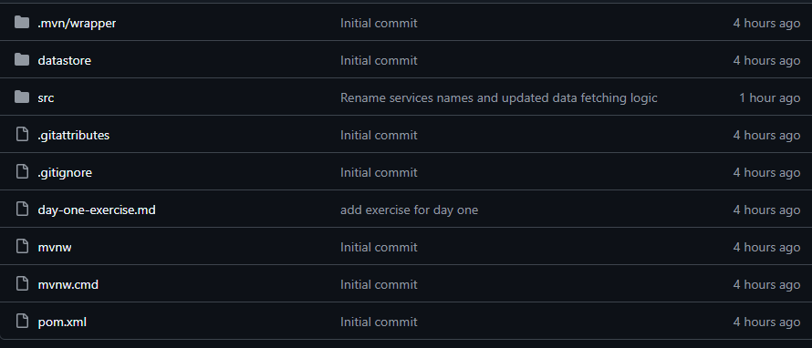
Homework and sample code

